Slide 1
Tweets Classification for Disaster Management using LSTM AND ANN
BHANU CHANDU RAVIPATI 70072988
PAVAN KALYAN RAO YELAMATI 700729168
HARI CHANDANA GADDAMPALLY 700726882

Slide 2
Introduction
Microblogging stages, for example, Twitter give dynamic correspondence channels during mass intermingling and crisis occasions such as quakes, tropical storms.
Preparing social media data represent numerous difficulties, for example, parsing uproarious, brief and casual messages, taking in data classifications from the approaching stream of messages and arranging them into various classes among others.
One of the fundamental necessities of huge numbers of these assignments is the accessibility of information, specifically human-commented on information.

Slide 3
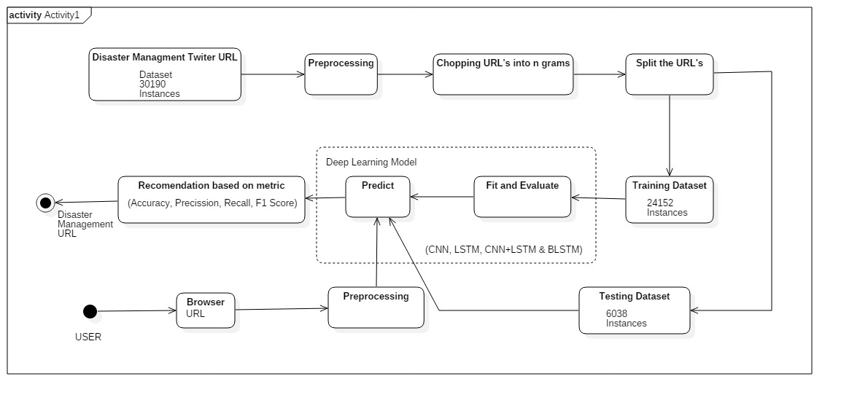
BLOCK DIAGRAM

Slide 4
ANN(ARTIFICIAL NUERAL NETWORK)
A neural network is a method in artificial intelligence that teaches computers to process data in a way that is inspired by the human brain. It is a type of machine learning process, called deep learning, that uses interconnected nodes or neurons in a layered structure that resembles the human brain.
Neural networks can help computers make intelligent decisions with limited human assistance. This is because they can learn and model the relationships between input and output data that are nonlinear and complex. For instance, they can do the following tasks

Slide 5
ADVANTAGES OF ANN
1)Medical diagnosis by medical image classification.
2)Targeted marketing by social network filtering and behavioral data analysis.
3) Financial predictions by processing historical data of financial instruments.
4) Electrical load and energy demand forecasting.
5) Process and quality control.
6) Chemical compound identification

Slide 6
DISADVANTAGES OF ANN
Artificial Neural Networks require lots of computational power.
Neural network models are hard to explain.
Neural network training requires lots of data.
Data preparation for neural network models needs careful attention.
Optimizing neural network models for production can be challenging.

Slide 7
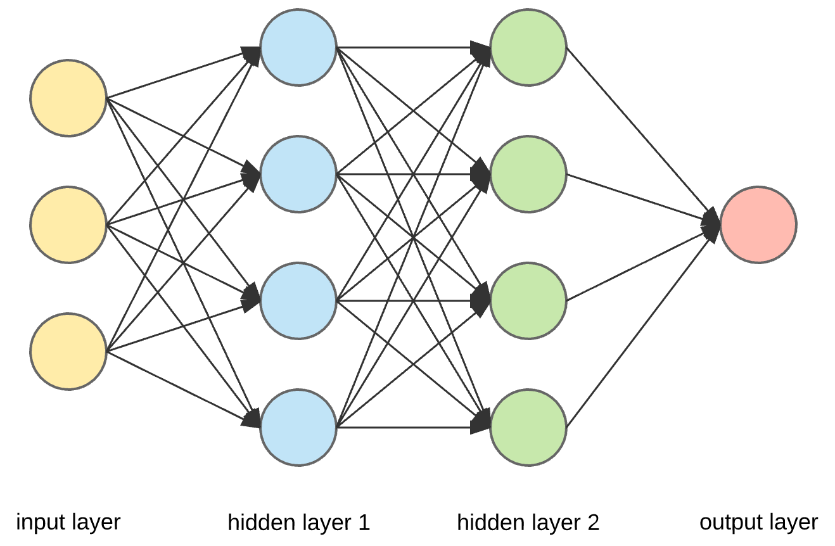
ANN MODEL

Slide 8
LSTM
Long short-term memory (LSTM) is an artificial Recurrent Neural Network (RNN) architecture used in the field of deep learning. Unlike standard feedforward neural networks, LSTM has feedback connections. It can not only process single data points (such as images), but also entire sequences of data (such as speech or video). For example, LSTM is applicable to tasks such as unsegmented, connected handwriting recognition], speech recognition and anomaly detection in network traffic or IDS's (intrusion detection systems).
A common LSTM unit is composed of a cell, an input gate, an output gate and a forget gate. The cell remembers values over arbitrary time intervals and the three gates regulate the flow of information into and out of the cell.

Slide 9
Disadvantages of LSTM
It cannot process very long sequences if it uses tanh as its activation function.
It is very unstable if we use ReLu as its activation function.
It cannot be stacked into very deep models.
This are not able to keep track of long-term dependencies.

Slide 10
WHY LSTM IS BETTER THAN ANN?
In the end, it is believed that the LSTM model may have the best predictive ability, but it is greatly affected by the data processing. The ANN model performs better than that of the ARIMA model. The combination of time series and external factors may be a worthy research direction

Slide 11
Gradient Descent
Training of neural network on large data using gradient descent.
In this there are 3 Steps:
Processing Data.
Loss function and evaluating, Back propagation.
Optimization using Stochastic Gradient Descent(SGD) and build a perfect model.

Slide 12
Gradient Descent
Gradient descent is one of ways to circumvent it. Basically it involves making optimizer steps after several batches thus increasing effective batch size.
Gradient descent is an optimization algorithm used to find the values of parameters (coefficients) of a function (f) that minimizes a cost function (cost).
Gradient descent is best used when the parameters cannot be calculated analytically (e.g. using linear algebra) and must be searched for by an optimization algorithm.

Slide 13
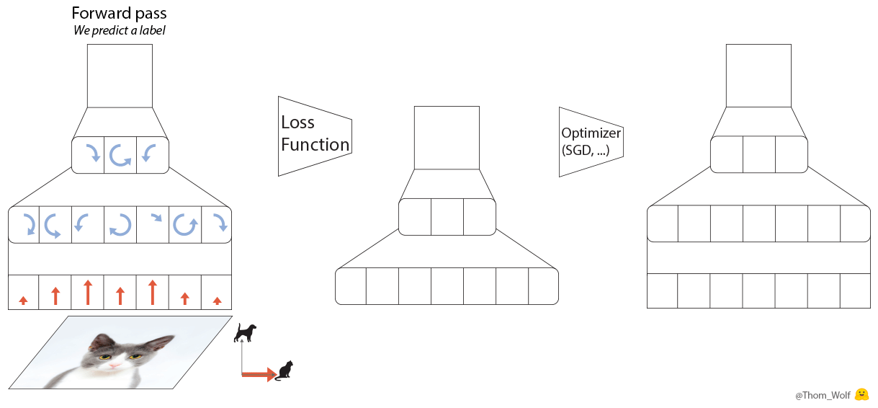
Block Diagram

Slide 14
Advantages of gradient Decent
It is easier to fit into memory due to a single training sample being processed by the network
It is computationally fast as only one sample is processed at a time
For larger datasets it can converge faster as it causes updates to the parameters more frequently
Due to frequent updates the steps taken towards the minima of the loss function have oscillations which can help getting out of local minimums of the loss function (in case the computed position turns out to be the local minimum)

Slide 15
Evaluation metrics
Classification Accuracy : The proportion of the total number of predictions that were correct.
F1 Score : F1-Score is the harmonic mean of precision and recall values for a classification problem.
Recall : The proportion of actual positive cases which are correctly identified.
Precision : The proportion of positive cases that were correctly identified

Slide 16
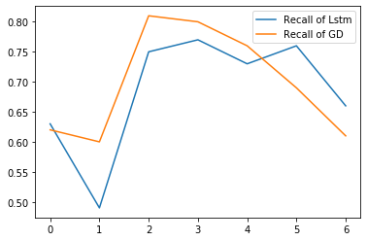
LSTM Results

Slide 17
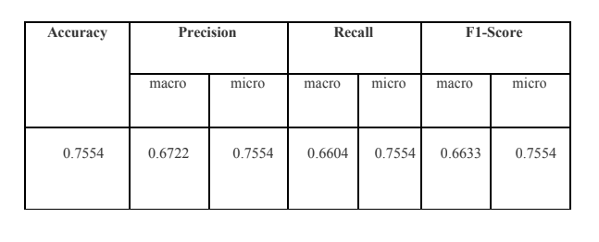
LSTM Results

Slide 18
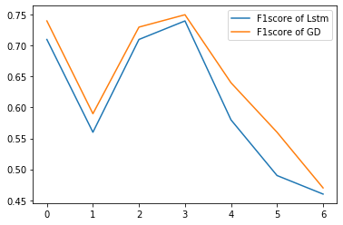
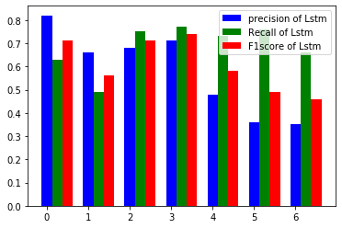
LSTM Results

Slide 19
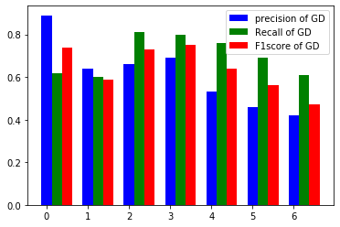
LSTM Results

Slide 20
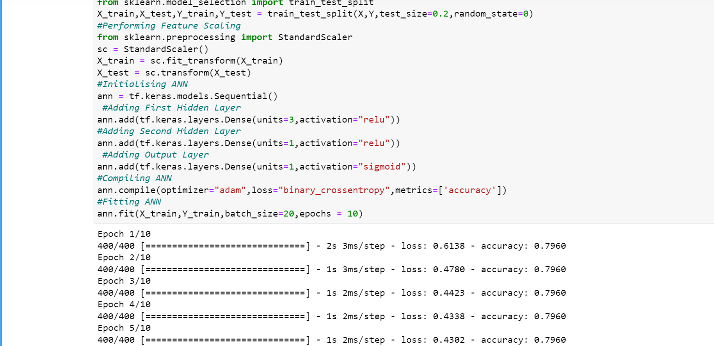
ANN RESULTS

Slide 21


